Slide 1
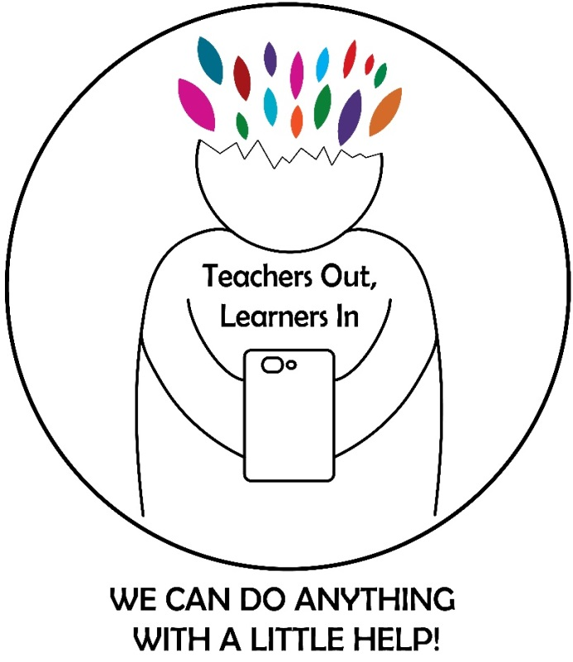

TEACHERS OUT LEARNERS IN
2016 – 2018

Slide 2
WHAT ARE WEB 2.0 TOOLS?
Web 2.0 Tools are online software programs that allow users to do a number of different things. They can be used to teach curriculum content, store data, create/edit video, edit photos, collaborate and so much more. These programs are often free and are used by teachers, students, and sometimes parents, both in and out of the classroom, on a pretty regular basis.

Slide 3
WHY USE WEB 2.0 TOOLS? (1)
As educators, the use of Web 2.0 tools is transforming our work, and more specifically the way we support students in the classroom. As schools bring more technology into their classrooms, teachers will in turn strive to put more technology in their students’ hands. That is, if they are prepared to do so.
The use of Web 2.0 Tools to support instruction is vital. How we use these tools is going to make a critical difference in how we measure our students success and how they are supported to meet 21st century skill sets.

Slide 4
WHY USE WEB 2.0 TOOLS? (2)
You might ask, “What’s the benefit of using Web 2.0 tools in teaching and learning?”.
Because Web 2.0 tools allow users to collaborate to generate/upload content, it is an excellent means to engage learners and help foster a community of learning in your course. For instance, you can ask students to create a glossary by taking turns to define concepts using their own words on a wiki page in CourseWeb. At the end of the semester, your students would have created a glossary in a “language” they understand.

Slide 5
WHY USE WEB 2.0 TOOLS? (3)
Another example is using a mind mapping tool like Popplet to help students brainstorm ideas asynchronously, meaning they do not need to contribute ideas at the same time (synchronously).
Students in a group can create a mind map on one space by adding their own ideas or commenting on group mates’ ideas at different times without meeting each other face-by-face. If necessary, students can even add multimedia files into their mind map to make it more comprehensible.
In the end, each group can have its mind map that is ready for sharing and feedback due to the convenient setup by those Web 2.0 tools.

Slide 6

HOW TO CHOOSE THE RIGHT TOOL?

Slide 7
HOW TO CHOOSE THE RIGHT TOOL?
There are many Web 2.0 tools available, and most of them are free or have free versions. Consequently, choosing the appropriate ones might be challenging.
The applicable Web 2.0 tools that support instruction are inserted to each learning domain, although one tool might be applicable to multiple domains. It is important to note that sound instructional design strategies should be in place in order to decide which tool can be used to support learning objectives.
The following pyramid might be a helpful guide, as it looks at available Web 2.0 tools from the perspective of the Bloom’s Taxonomy.

Slide 8
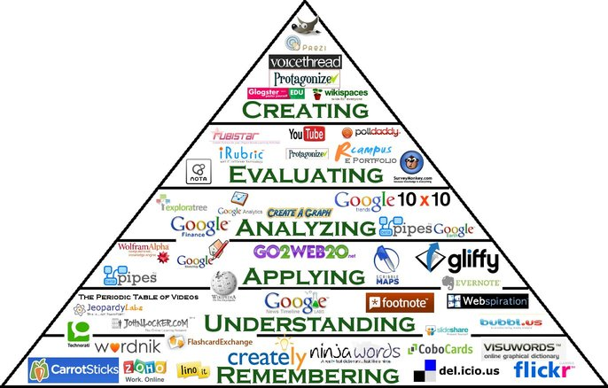
We can find the right tool according to many criteria,
for instance task, product, cognitive level, learning style and so on.

Slide 9
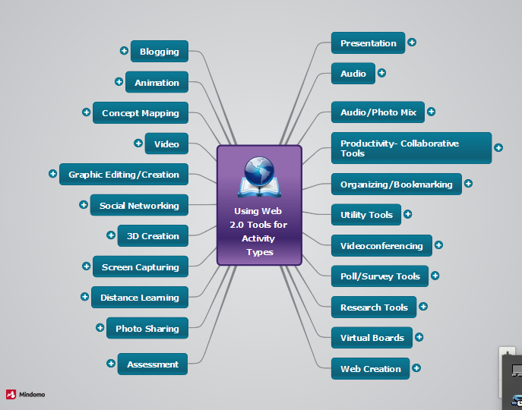
Here is what you can do with web 2.0 tools:

Slide 10
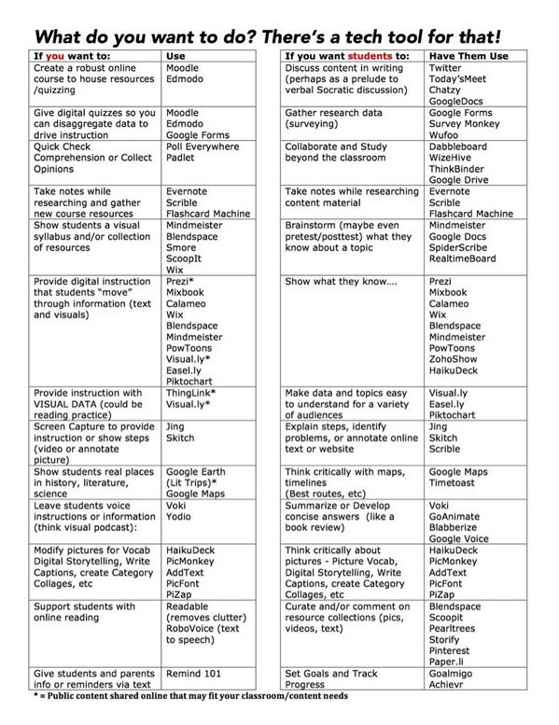

Slide 11
HOW CAN WE CLASSIFY THEM?
There are lots of possible classifications, but we have decided to keep it simple, therefore our analysis comes down to the three categories that in our opinion are the most useful for both teachers and learners: presentation and graphics tools, learning/ teaching tools, assessment tools.

Slide 12
THESE ARE THE MOST USEFUL
Presentation and graphics tools:
Photo Peach
Thinglink
Adobe Spark
Biteable
Prezi
Wordclouds
Glogster
Zoho Docs

Slide 13
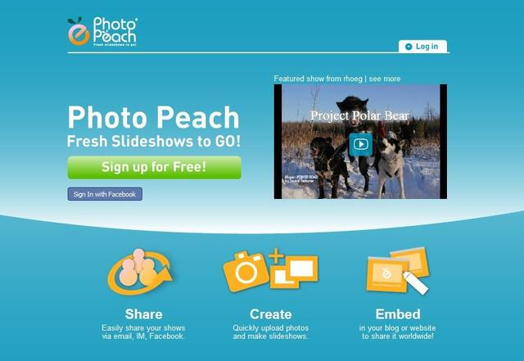

Photo Peach
Our idea is to help you tell better stories online using photos.
With Photo Peach you can create a rich slideshow in seconds to engage your students. According to your purpose you can use background music, captions, and comments so you can elaborate on your story further. It’s great for collaborative group work.
By using the “quiz” feature you can even create an interactive slideshow with multiple choice questions on any or all slides.

Slide 14
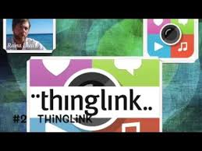

Thinglink
It is an interactive image tool that provides users with the ability to turn any image into a multimedia launcher.
Users can create multiple "hot spots" on specific parts of an image and turn the image into a multimedia launcher.
You can embed video, record audio with the click of a button and a free SoundCloud account, or link to any website.

Slide 15

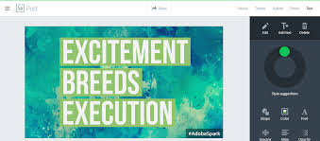
Adobe Spark
It creates impactful social graphics, web stories and animated videos.
Your text, photo or video instantly come to life with fluid elegant motion. We call it a GLIDESHOW.

Slide 16


Biteable
Biteable is the world’s simplest video maker. It is done completely online in a matter of minutes. You can add your own music, themes, images, and templates. By adding animations it helps attract students attention effectively. Biteable can be used by both teachers and students.

Slide 17


Prezi
Prezi is web-based presentation software, whose interactive nature makes it a popular classroom tool. Its freedom of movement enables “conversational presenting,” a presentation style in which presentations follow the flow of dialogue, instead of vice-versa.
The company has worked closely with the ConnectED initiative since its inauguration by President Barack Obama in 2013, providing free Prezi licenses to hundreds of thousands of Title 1 high school teachers across the nation.

Slide 18


WordClouds
It is a free online word cloud generator and tag cloud creator.
It works on your PC, Tablet or smartphone. Paste text, upload a document or open an URL to automatically generate a word- or tag cloud.
Customize your cloud with shapes, themes, colors and fonts.
You can also edit the word list, cloud size and gap size.
It can also generate clickable word clouds with links (image map).
When you are satisfied with the result, save the image and share it online.

Slide 19

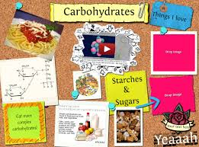
Glogster
Glogster is a great creativity site whose tag line is “poster yourself”.
A ‘glog’ is basically an online poster web page.
Students can combine text, pictures, graphics, video, and audio to create an interactive online poster. They can click and drag items out of Glogster’s resources, choose their own backgrounds, pictures, text boxes, videos, web links, and more! Glogster has a very simple-to-use interface. The final glog can be hosted by Glogster or you can embed it into awiki, blog or class web site.

Slide 20
THESE ARE THE MOST USEFUL
Learning:
Timetoast
Mindomo
Crossword Labs
Moodle
Kahoot
Quizlet
Edmodo
Animoto
Khan Academy

Slide 21

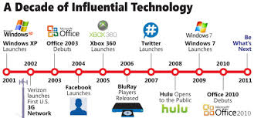
Timetoast
It allows you to create dynamic projects, explore topics that lend themselves to a chronological presentation.
You organize your presentation along a timeline based on dates and the elements you include are clickable, so that they can expand (including media in addition to text).
There a lot of different sites, for example Tiki-Toki.com

Slide 22

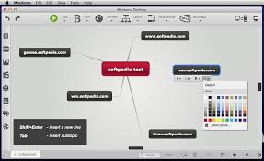
Mindomo
It is a useful mind mapping and idea management software, available in cloud and desktop versions.
It is online collaborative mind mapping, concept mapping and outliningsoftware for visualizing and organizing information.
Watch out for its freemium version!

Slide 23
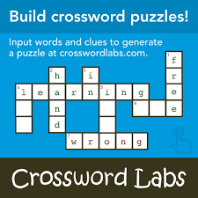
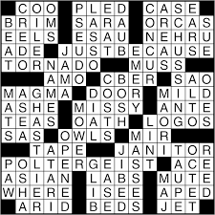
Crossword Labs
It’s the simplest way to build, print, share and solve cross word puzzles online.
It’s free, fast and easy.

Slide 24

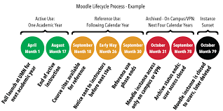
Moodle
It is a learning platform designed to provide educators, administrators and learners with a single, robust , secure and integrated system to create personalised learning environments.
The software can be downloaded. You can ask a knowledgeable Moodle partner to assist you.
It is proven, trusted worldwide, easy to use, free, up to date, in your own language, flexible, highly customisable, scalable to any size and device.

Slide 25

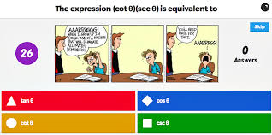
Kahoot
You can create a fun learning game in minutes and make a series of multiple choice questions. The format and number of questions are entirely up to you. Add videos, images and diagrams to your questions to amplify engagement.
Kahoots are best played in a group setting, like a classroom. Players answer the questions on their own devices, while games are displayed on a shared screen to unite the lesson.
Social learning promotes discussion and pedagogical impact, whether players are in the same room or on the other side of the globe. It encourages players to create and share their own kahoots to deepen understanding.

Slide 26

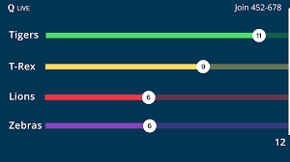
Quizlet
You have a test in a few days. Quizlet creates a set with materials for you to work on. When they start it, they use machine learning to analyse millions of anonymous study sessions, then they combine data and techniques for cognitive science as the best way to study and retain information.
You tell them what materials you need to master and when you need to know them by. They build you an adapted study plan.
As the student studies, Quizlet recognizes patterns and adjusts the questions the students see to be easier or harder. Quizlet updates on the student’s progress and sends study reminders.
When you hit 100% you know you are ready.

Slide 27
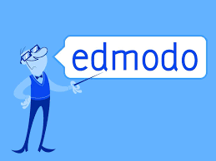
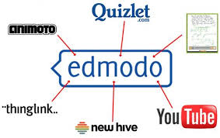
Edmodo
To create a network, teachers will begin by creating an account.
Next, students can join by going to the same website. In order to join, they will need to have a private access code provided by the teacher. The code will enable the student to access the main page for the classroom. Fortunately, students are not required to enter any personal information so the site is completely secure. Not only that, but students do not need to have an email account in order to set up an account.
Teachers can then create subgroups which can eliminate cross posting. When the course is over, the teacher can close out the network. Later, the teacher can create a new network for the next course.

Slide 28

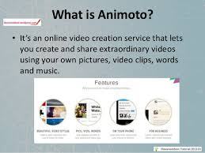
Animoto
It is a cloud-based video creation service that produces videos from photos, video clips and music into video glide shows.
It is for presentations and projects both for teachers and students.

Slide 29


Khan Academy
Khan Academy's website aims to provide a personalized learning experience, mainly built on the videos which are hosted on YouTube. The website is meant to be used as a supplement to its videos, because it includes other features such as progress tracking, practice exercises, teaching tools. The material can also be accessed through mobile applications.
The videos show a recording of drawings on an electronic blackboard, which are similar to the style of a teacher giving a lecture. The narrator describes each drawing and how they relate to the material being taught. Nonprofit groups have distributed offline versions of the videos to rural areas in Asia, Latin America, and Africa.Videos range from all subjects covered in school and for all grades, Kindergarten to High School.

Slide 30
THESE ARE THE MOST USEFUL
Assessment:
Socrative
Hot Potatoes
ProProfs
Joomla
Riddle
Testmoz
Kahoot
Edmodo

Slide 31
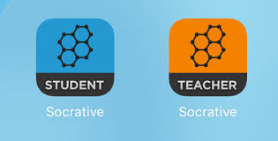
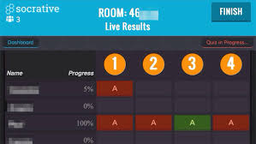
Socrative
Socrative is your classroom app for fun, effective classroom engagement. No matter where or how you teach, Socrative allows you to instantly connect with students as learning happens.
Quickly assess students with prepared activities or on-the-fly questions to get immediate insight into student understanding.
Then use auto-populated results to determine the best instructional approach to most effectively drive learning.

Slide 32
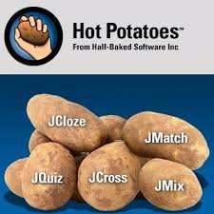
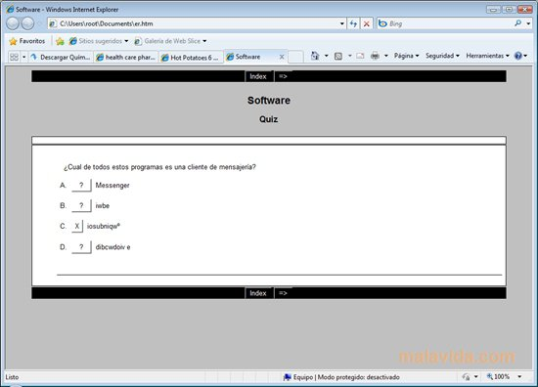
Hot Potatoes
The Hot Potatoes suite includes six applications, enabling you to create interactive multiple-choice, short-answer, jumbled-sentence, crossword, matching/ordering and gap-fill exercises for the World Wide Web.
Hot Potatoes is freeware, and you may use it for any purpose or project you like.
It is not open-source.

Slide 33

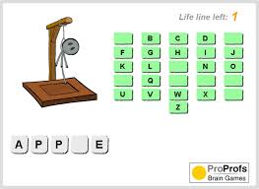
ProProfs
ProProfs Quiz Maker is the perfect software to create and deliver online exams and tests.
Easily create online quizzes, secure tests and assessments for students or employees.
Using our e-learning software, you can even add survey or poll and gather feedback from learners.
Receive detailed reports and statistics for your quizzes to analyze the performance of your learners. ProProfs Quiz Maker makes it easy to create quizzes anytime, anywhere!

Slide 34


Joomla
Joomla is a free and open-source content management system (CMS) for publishing web content.
It is built on a model-view-controller web application framework that can be used independently of the CMS.

Slide 35


Riddle
Riddle is an excellent web tool for teachers.
It allows to create their own PlayBuzz and Buzzfeed-style quizzes, lists, pools and more often in under a minute.
Riddle’s goal is to provide best-in-class tools that making creating interactive content simple, so you can concentrate on the content instead of worrying about the tools.

Slide 36

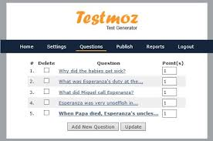
Testmoz
Testmoz is a simple test generating application created by Matt Johnson, an undergraduate student at Washington State University, Vancouver.
Testmoz is a test generator that sports 4 question types, automatic grading, a really simple interface and detailed reports.
Testmoz is free, and does not require you (or your students) to register.
You can build a fully functional test in about a minute.
And for about $20/year, you can unlock some potentially useful features.

Slide 37
Kahoot
It is also a student response system that teachers can use to create and deliver quizzes and surveys to students. Kahoot provides a learning environment that is ideal for engaging students for it incorporates the precepts of both game-based learning and inquiry-based learning.
It allows teachers to create quizzes and surveys that include a wide variety of multimedia elements such as videos, pictures and text. Each quiz you create can be accessed by students across different devices. Also teachers have the possibility to create time-controlled quizzes. You can set a specific period of time for the answer of each question. In this way students are rewarded not only for the correct answer but also for their timeliness.

Slide 38

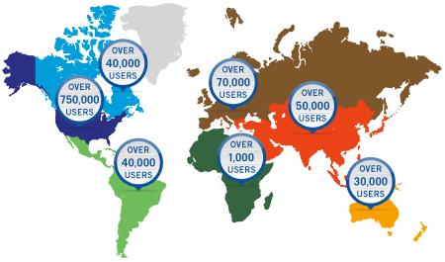
Edmodo
Edmodo is also a great resource for teachers and learners.
Teachers have the ability to assign homework and share notes, links, and files. In addition to this, teachers can post alerts, reminders and share events.
Through Edmodo, teachers can make connections with other educators with similar interests.

Slide 39
References
https://biteable.com
https://blog.edmodo.com
https://crosswordlabs.com
https://edu.glogster.com
https://joomla.org
https://kidsdiscover.com/teacherresources/web-2-0-tools-classroom
https://mindomo.com
https://moodle.net

Slide 40
References
https://proprofs.com
https://quizlet.com
https://riddle.com
https://socrative.com
https://testmoz.com
https://timetoast.com
https://webtools4u2use.wikispaces.com/finding+the+right+tool
https://youtube.com/user/khanacademy
https://youtube.com/watch?v=Aq4NnIFItAk

